Slide 1

Varendra University
Dept. of Computer Science & Engineering (CSE)
Basic Discussion
Course Title: Microprocessor and Assembly Language
Course No: CSE 3205
Prepared By:
Md. Adnan Sami
Lecturer, Dept. of CSE, VU

Slide 2
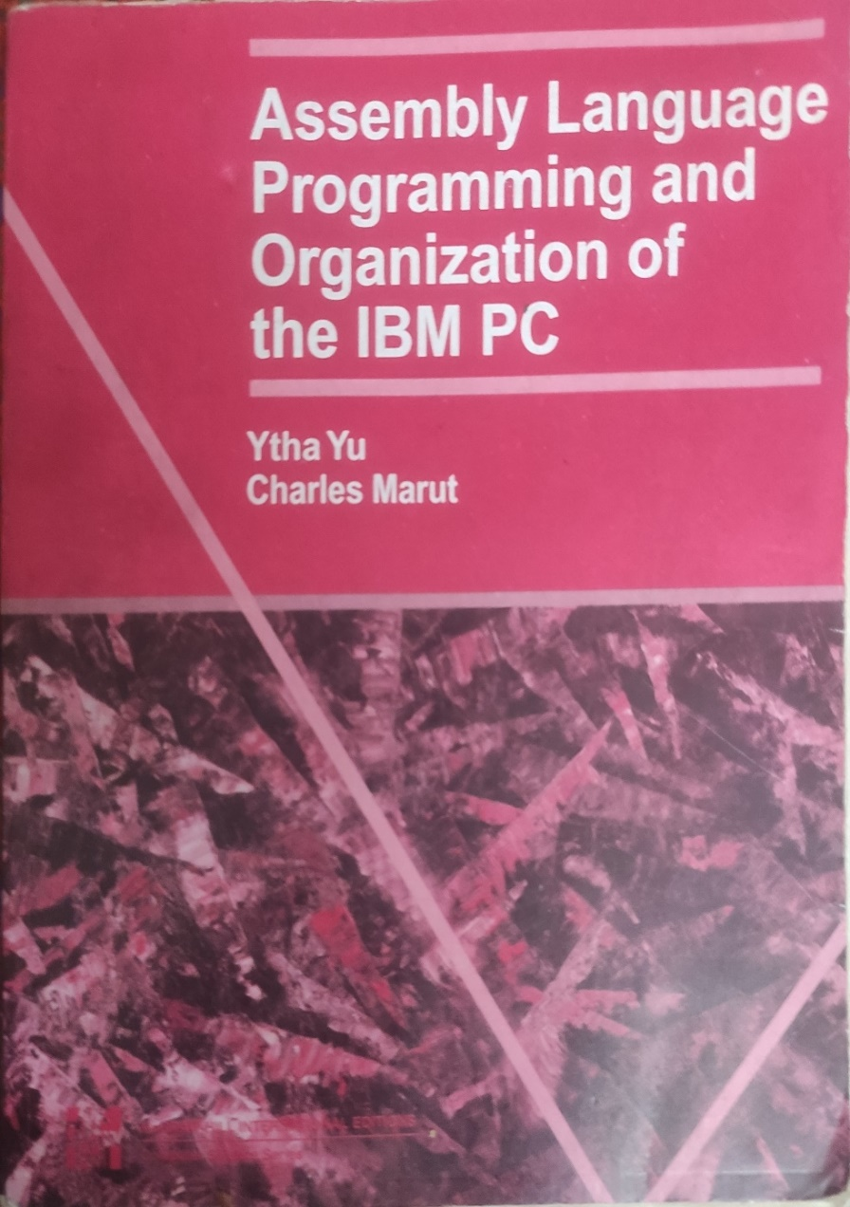
Reference Book

Slide 3
Outline
Component of a microcomputer system.
Why CPU is called the brain of the computer.
Operation of Control Unit.
Operation of Arithmetic Logic Unit (ALU).

Slide 4
Component of a microcomputer system
Three parts of computer system.
Central Processing Unit (CPU).
Memory.
I/O Devices.

Slide 5
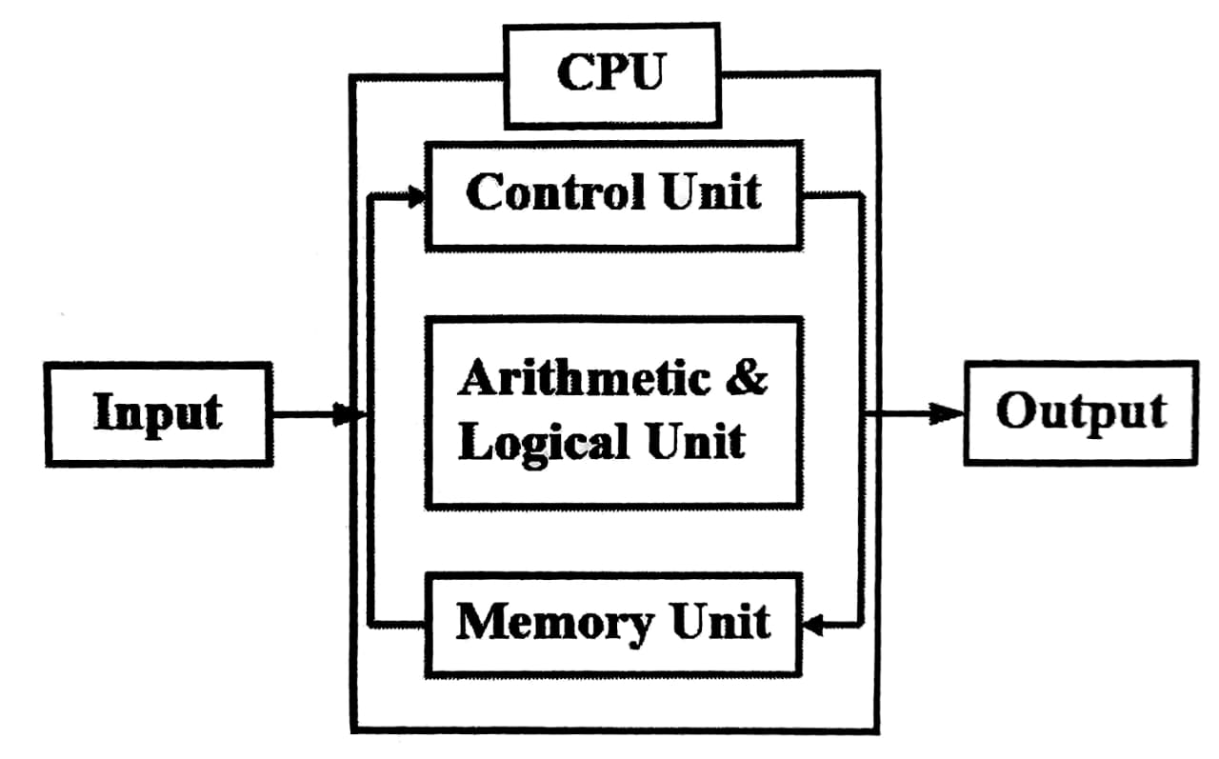
Component of a microcomputer system

Slide 6
Component of a microcomputer system
Working Principal:
Central processing unit (CPU): It controls the operation of the computer.
Memory: It stores data.
I/O Device: Moves data between the computer and its external environment.

Slide 7
Why CPU is called the brain of the computer
CPU controls the operation of the computer.
All instructions are executed in CPU.

Slide 8
Operation or Function of Control Unit
Fetch: Control unit fetches instructions from memory that need to be executed.
Decode: After fetching, control unit decodes the instruction. Decode means understand the binary pattern.
Execution: After decoding, control unit executes the instruction.

Slide 9
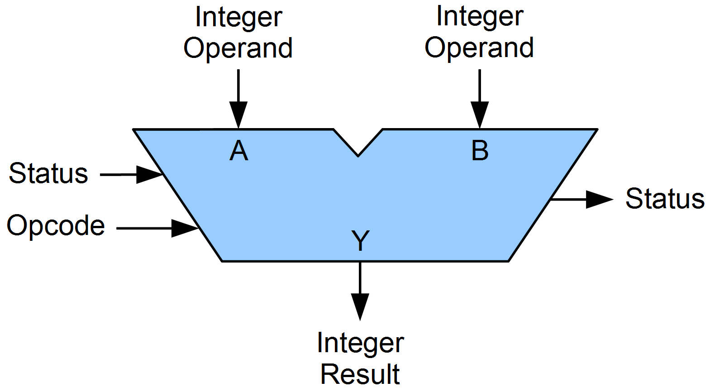
Operation of Arithmetic Logic Unit (ALU)

Slide 10
Operation of Arithmetic Logic Unit (ALU)
Arithmetic Operation: Arithmetic operation like addition, subtraction, multiplication etc. is performed.
Logical Operation: Logical operation like AND, OR, NOT is performed.
Data Manipulation: Altering or transforming data to make it more manageable and meaningful.

